Slide 1




Slide 2

Venn Diagram

Slide 3

TEST TIME ON PERMUTATION AND COMBINATIONS-2
QR CODE:

Slide 4
Venn Diagram
Venn Diagrams is a way of depicting sets. Venn Diagrams consist of closed shapes, generally circles, which represent sets. The capital letter outside the circle denotes the name of the set while the letters inside the circle denote the elements of the set.
The various operations of sets are represented by partial or complete overlap of these closed figures. Regions of overlap represent elements that are shared by sets.
In practice, sets are generally represented by circles. The universal set is represented by a rectangle that encloses all other sets.

Slide 5
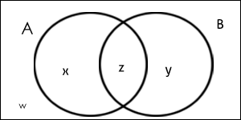
Venn Diagram
Venn diagram, also known as Euler-Venn diagram is a simple representation of sets by diagrams.
A Venn diagram uses overlapping circles or other shapes to illustrate the logical relationships between two or more sets of items.
Venn diagram, also known as Euler-Venn diagram is a simple representation of sets by diagrams. The usual depiction makes use of a rectangle as the universal set and circles for the sets under consideration.
For Example:

Slide 6
Venn Diagram
Some of the basic terms we should know in venn diagrams
n ( A ∪ B) = n(A ) + n ( B ) - n ( A∩ B)
n (A ∪ B ∪ C) = n(A ) + n ( B ) + n (C) - n ( A ∩ B) - n ( B ∩ C) - n ( C ∩ A) + n (A ∩ B ∩ C )
Where,
n(A) = number of elements in set A.
n(B) = number of elements in set B.
n(C) = number of elements in set C.
n (A ∪ B) = number of elements in both set A and set B.
n(A ∩ B) = number of elements common in set A and set B.
In the case of three elements,
n(A ∪ B ∪ C)= number of elements in set A,set B and set C.
n (A ∩ B ∩ C )=number of elements common in all the three.

Slide 7
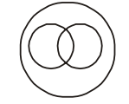



Question: 01
Which one of the following diagrams best depicts the relationship among pen, pencils, stationery?
A.
B.
C.
D.

Slide 8
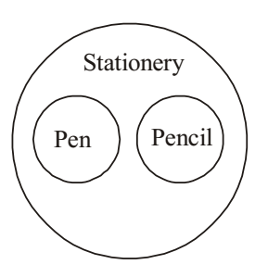
CLOCKS
Explanation: 01
From the given above question , we have Pen is different from Pencil. But both are stationery items. Therefore , option ( C ) is correct answer .

Slide 9



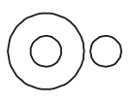
Question: 02
Identify the diagram that best represents the relationship among the classes given below: Doctors, Engineers, Lawyers
B.
A.
D.
C.

Slide 10
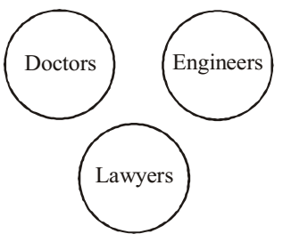
Explanation: 02
According to question , we know that Doctors, Engineers and Lawyers are different in professions .These belong to different classes . So , option ( D ) is required answer .

Slide 11

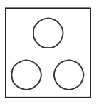
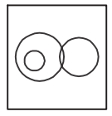
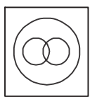
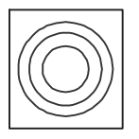
Question: 03
Select the Venn diagram that correctly shows the relationship. Continent , City and Country
A.
B.
C.
D.

Slide 12
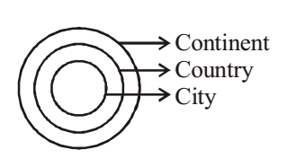
Question: 01
Explanation: 03
According to question , we can say that City and Country belong to Continent . From above it is clear that option D is required answer .

Slide 13


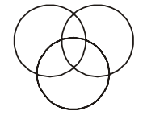
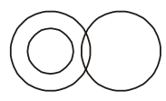
Question: 04
Which figure will best represent the relationship amongst the three classes? Boy, Sportsman, Student
A.
B.
C.
D.

Slide 14
Explanation: 04
According to question ,we can say that
Some boys are sportsmen .
Some boys are students
Some sportsmen are students.
From above it is clear that option C represents the best relationship between Boy, Sportsman, Student .

Slide 15




Question: 16
Question: 05
In the accounts department of a company, there are some who are only chartered accountants and some who are only cost accountants. A few hold both chartered and cost accountancy qualifications. Besides these there are others who hold Management accountancy qualifications. Some of these management accountants have also done either chartered or cost accountancy or both. Which of the following figures represents these facts?
A.
B.
C.
D.

Slide 16
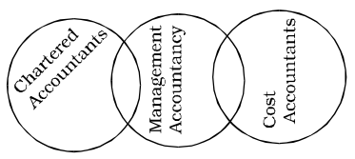
Question: 09
Explanation: 05
As per the given above question ,we know that Some chartered accountants may be Management accountancy and vice-versa. Some cost accountants may be Management accountancy and vice-versa. But chartered accountants are entirely different from the cost accountants. From above it is clear that option ( A ) represents the best relationship between chartered accountants, Management accountancy and cost accountants .

Slide 17




Question: 02
Question: 06
In a group of 40 players, some play cricket, some play football and some both. If 30 play cricket and 20 both, the correct way of representing above by Venn Diagram is
A.
B.
C.
D.

Slide 18

Explanation: 06
According to question , Given :- Total numbers of players = 40 Numbers of players playing cricket = 30 Numbers of players playing cricket and football both = 20 ∴ Numbers of players playing football = 20 + 10 = 30 Hence , option C will be required answer .

Slide 19

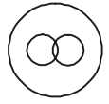


Question: 07
Which one of the following Venn diagrams represents the best relationship between Snake, Lizard, Reptiles?
A.
B.
C.
D.

Slide 20
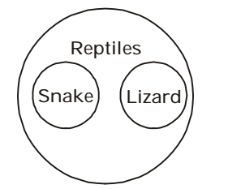
Explanation: 07
According to above given question , we know that Snake is different from Lizard, but both are reptiles. From above it is clear that option ( B ) represents the best relationship between Snake, Lizard and Reptiles .

Slide 21
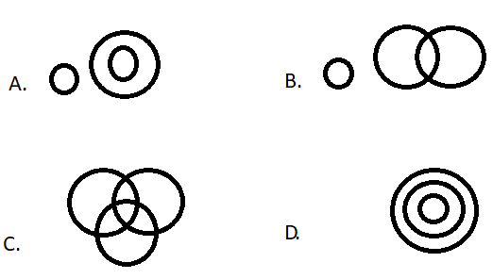
Question: 04
Question: 08
Select from the given diagram the one that illustrates the relationship among the given 3 classes: children below 18, persons in the electoral list, those who have voted.

Slide 22
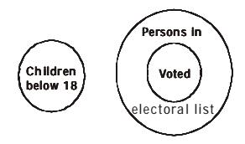
Explanation: 08
According to above given question , we can say that children below 18 are different from persons in the electoral list and those who have voted. From above it is clear that option ( A ) represents the best relationship between children below 18, persons in the electoral list and those who have voted . As shown in given Venn - diagram .

Slide 23
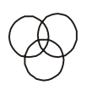



Question: 05
Question: 09
Which diagram represents the relationship between Women, Mothers and Engineers?
A.
B.
C.
D.

Slide 24
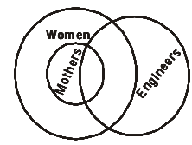
Explanation: 09
From above given question , we can say that All mothers are women. Some women are mothers. Some mothers may be engineers. From above it is clear that option ( D ) represents the best relationship between Women, Mothers and Engineers. As shown in given Venn - diagram .

Slide 25
Question: 10
In a survey of 500 students of a college, it was found that 49% liked watching football, 53% liked watching hockey and 62% liked watching basketball. Also, 27% liked watching football and hockey both, 29% liked watching basketball and hockey both and 28% liked watching football and basketball both. 5% liked watching none of these games.
How many students like watching all the three games?
A. 55
B. 40
C. 75
D. 60

Slide 26

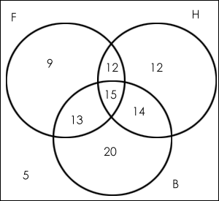
Explanation:
Explanation: 10
n(F) = percentage of students who like watching football = 49% n(H) = percentage of students who like watching hockey = 53% n(B)= percentage of students who like watching basketball = 62% n ( F ∩ H) = 27% ; n (B ∩ H) = 29% ; n(F ∩ B) = 28% Since 5% like watching none of the given games so, n (F ∪ H ∪ B) = 95%. Now applying the basic formula, 95% = 49% + 53% + 62% -27% - 29% - 28% + n (F ∩ H ∩ B) Solving, you get n (F ∩ H ∩ B) = 15%.
Number of students who like watching all the three games = 15 % of 500 = 75

Slide 27
Question: 11
In a survey of 500 students of a college, it was found that 49% liked watching football, 53% liked watching hockey and 62% liked watching basketball. Also, 27% liked watching football and hockey both, 29% liked watching basketball and hockey both and 28% liked watching football and basketball both. 5% liked watching none of these games.
Find the ratio of number of students who like watching only football to those who like watching only hockey?
A. 3:4
B. 2:3
C. 1:2
D. 3:2

Slide 28
Explanation:
Explanation: 11
n(F) = percentage of students who like watching football = 49%
n(H) = percentage of students who like watching hockey = 53%
n(B)= percentage of students who like watching basketball = 62%
n ( F ∩ H) = 27% ; n (B ∩ H) = 29% ; n(F ∩ B) = 28%
Since 5% like watching none of the given games so, n (F ∪ H ∪ B) = 95%.
Now applying the basic formula,
95% = 49% + 53% + 62% -27% - 29% - 28% + n (F ∩ H ∩ B)
Solving, you get n (F ∩ H ∩ B) = 15%.
Ratio of the number of students who like only football to those who like only hockey = (9% of 500)/(12% of 500)
= 9/12 = 3:4.

Slide 29
Question: 08
Question: 12
In a survey of 500 students of a college, it was found that 49% liked watching football, 53% liked watching hockey and 62% liked watching basketball. Also, 27% liked watching football and hockey both, 29% liked watching basketball and hockey both and 28% liked watching football and basketball both. 5% liked watching none of these games.
Find the number of students who like watching only one of the three given games?
A. 190
B. 200
C. 100
D. 205

Slide 30
Explanation:
Explanation: 12
n(F) = percentage of students who like watching football = 49%
n(H) = percentage of students who like watching hockey = 53%
n(B)= percentage of students who like watching basketball = 62%
n ( F ∩ H) = 27% ; n (B ∩ H) = 29% ; n(F ∩ B) = 28%
Since 5% like watching none of the given games so, n (F ∪ H ∪ B) = 95%.
Now applying the basic formula,
95% = 49% + 53% + 62% -27% - 29% - 28% + n (F ∩ H ∩ B)
Solving, you get n (F ∩ H ∩ B) = 15%.
The number of students who like watching only one of the three given games = (9% + 12% + 20%) of 500 = 205

Slide 31




THANK YOU
+91 78150 95095
codemithra@ethnus.com
www.codemithra.com

